Slide 1
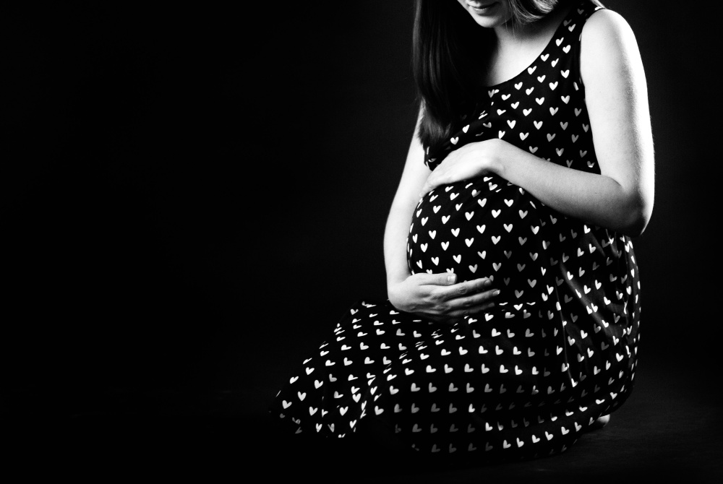
A Christian’s View of the
Unborn
Psalm 139:1-16
Notes:
(Psalm 139:1-16) [The Psalmists view of God’s personal involvement in his own existence] READ
Note especially verses (13-16), “For You formed my inward parts; You covered me in my mother's womb. ¹⁴ I will praise You, for I am fearfully and wonderfully made; marvelous are Your works, and that my soul knows very well. ¹⁵ My frame was not hidden from You, when I was made in secret, and skillfully wrought in the lowest parts of the earth. ¹⁶ Your eyes saw my substance, being yet unformed. And in Your book they all were written, the days fashioned for me, when as yet there were none of them.”
I have a very strong conviction that I want to share with you this morning
It is my belief that human life begins at conception. It is a belief that I consider to be founded in logic, science, and most importantly in the scriptures.
There have been approximately 61 million surgical abortions in the United States since the Roe V Wade decision legalized the procedure in 1973.
Worldwide, since 1980, approximately 1.5 billion
The website numberofabortions.org supplies a running clock that will make you will as you watch the numbers change by the second.
Gone are the days when the mantra was repeated over and over again by pro-abortion advocates that they desired for abortion to be “safe, legal and rare.”
For many it is seen as merely the last option for birth control. It is disingenuous to claim the desire for abortion to be rare, when our society has put into place measures that have led to a present rate of nearly 1,000,000 abortions a year.
As I believe each abortion to be the taking of a human life, I have to be consider this the greatest worldwide and national scourge of our generation.
(Jeremiah 5:23-29), [As with Israel, I fear this description given by Jehovah is apt today], “But this people has a defiant and rebellious heart; they have revolted and departed. ²⁴ They do not say in their heart, “Let us now fear the Lord our God, Who gives rain, both the former and the latter, in its season. He reserves for us the appointed weeks of the harvest.” ²⁵ Your iniquities have turned these things away, and your sins have withheld good from you. ²⁶ “For among My people are found wicked men; they lie in wait as one who sets snares; they set a trap; they catch men. ²⁷ As a cage is full of birds, so their houses are full of deceit. Therefore they have become great and grown rich. ²⁸ They have grown fat, they are sleek; yes, they surpass the deeds of the wicked; they do not plead the cause, the cause of the fatherless; yet they prosper, and the right of the needy they do not defend. ²⁹ Shall I not punish them for these things?’ says the Lord. ‘Shall I not avenge Myself on such a nation as this?’”

Slide 2
Not Politics!
The weak need peace & comfort
The ignorant need the truth
The evil must be met with good
Notes:
Despite the political climate, (brought into sharp relief with the Brett Kavanaugh appointment to the Supreme court) the purpose of this sermon is not to add another voice to the political discussion:
Things a Christian needs to keep in mind.
Most who decide to have an abortion are scared, confused, conflicted. We do not condone their sin, but we acknowledge these things may be done in weakness or ignorance. Our purpose is not to condemn any such individual, but to bring them to repentance, and to the peace and comfort that is found in Jesus Christ.
(Matthew 10:28-30), [Jesus’ promise], “Come to Me, all you who labor and are heavy laden, and I will give you rest. ²⁹ Take My yoke upon you and learn from Me, for I am gentle and lowly in heart, and you will find rest for your souls. ³⁰ For My yoke is easy and My burden is light.”
Many who advocate for abortion are sincere in their belief that they are not killing a human being, and they are protecting a woman against hostile intrusions into her personal and private choices. Our purpose is not to rail against these people, but to inform them. To expose them to the truth.
(John 8:32), [Jesus’ promise], “And you shall know the truth, and the truth shall make you free.”
Many who advocate for abortion are hostile, evil, selfish, and do not care for the sanctity of human life. However, it is always wrong to return evil with evil. Zeal on the part of the Christian should never be corrupted into enmity, hatefulness, and ungodly behavior in the midst of conflict.
(Matthew 5:16), [Jesus’ admonition to us], “Let your light so shine before men, that they may see your good works and glorify your Father in heaven.”
(Romans 12:21), “Do not be overcome by evil, but overcome evil with good.”

Slide 3
The Unborn are Living Souls!
Science
Notes:
(Genesis 2:7), “And the Lord God formed man of the dust of the ground, and breathed into his nostrils the breath of life; and man became a living soul.”
When we affirm this, we are saying that an unborn child is alive
We are saying that the unborn is human
We are saying the unborn is deserving of, and in need of our protection
We are saying that the abortion of a fetus is the killing of a helpless human being
I am not a scientist, and the Bible isn’t a scientific work. But, there are a few things I want you to consider.

Slide 4
Roe V Wade and Viability
In 1973, the court based the “state’s interest” to be limited to the time where a fetus is considered viable (24-28 weeks, 3rd trimester)
Today, 22 weeks (25%), 26 weeks (90%) survive
Question: Is viability a legitimate way to distinguish between life and “potential life”?
Notes:
First, the ROE V WADE decision to allow abortion was decided in part upon the concept of viability
1st trimester, state stay out of it. “Potential life” is the word used.
2nd trimester, state can regulate for the woman’s health. Still no argument regarding protecting the unborn
3rd trimester, state can outlaw abortion, unless to preserve the life of the mother, because the fetus is now viable. (Can live outside the womb). (In 1973, between 24 and 28 weeks, restrictions could be imposed by the state on a case by case basis, from 28 to birth, abortion could be made unlawful)
Today, 25% of babies born at 22 weeks survive if actively treated at the hospital. The survival rate for 26 weeks is now at 90%).
Regardless, it is important to ask the question as to whether viability is a legitimate test to determining if an unborn child is alive.
Consider first the state of the unborn at four months pregnancy, well before the child can live outside the womb.

Slide 5
The unborn at 16 weeks gestation
Body fully formed with fingers and toes
Unborn moves, sucks it’s thumb, kicks
Unborn inhales and exhales fluid in lungs
Unborn can blink eyelids
Genitals formed, (girl: uterus & ovaries in place)
Purposeful movement seen among twins
Notes:
The unborn child at 16 weeks (4 months) gestation, according to the general consensus in the scientific community:
The child is about 5 inches long and weighs about 3 ounces, about the size of a large avocado.
The body is fully formed, the fingers and toes have fingerprints & nails.
The baby is moving about: it may grasp for the umbilical cord , suck it's thumb, and is capable of making facial expressions and kicking at the amniotic sac.
The heart & circulatory system and the urinary tract are fully functioning. and the blood is pumping through these tiny veins
The baby is inhaling and exhaling the amniotic fluid through the lungs.
The eyes are in the proper position, and the baby can see straight ahead & blink his/her eyelids.
The genitals have formed. In the case of a girl, the uterus has already developed and the ovaries are in the proper place.
Umberto Castiello, University of Padova, Italy (in a study observing the behavior of twins in the womb), reported that unborn babies have the ability to interact as early as 14 weeks into the pregnancy: "We conclude that performance of movements towards the co-twin is not accidental: already starting from the 14th week of gestation twin fetuses execute movements specifically aimed at the co-twin."

Slide 6
Viability – Inside and Outside the womb
Alive; capable of living, developing, or reproducing; 2) Able to live on its own or outside the uterus, used of an embryo, fetus or newborn
The womb is an aid to sustain life. Why distinguish between it, and other aids that are necessary to sustain life? (life VS potential?)
Notes:
What does the word “viable” mean?
(biology-online.org) - 1) Alive; capable of living, developing, or reproducing, as in a viable cell. 2) Able to live on its own or outside the uterus, used of an embryo, fetus or newborn
Consider first that the word viable is used even of a newborn. That is, one outside of the womb. Not all babies who are born alive are viable. Some die shortly after birth. Does that mean that they were never human because they were never going to be able to live outside the womb?
If they are human, then the only transition between human life and potential life is the birth canal. This is absurd, and without any scientific basis.
Why is viability used to determine human life ONLY in that stage between conception and birth?
A person with diseased kidneys is not viable. He can’t live on his own. He is dependent upon a dialysis machine
A person with severe diabetes is not viable. He can’t live on his own. He is dependent upon insulin injections.
A person with severe COPD is not viable. He can’t live on his own. He is dependent upon an oxygen concentrator.
Interestingly, the only distinction here is that life is sustained by artificial means. This is not so with a mother’s womb. It is a natural, nurturing home for the unborn. In other words, men in the past have died because they did not have access to what other men invent and supply. No man supplies a womb. The baby is only dependent upon the mother.
I, of course, could go on and on. The question is humanity. The question is life. The question is NOT viability.
So, let’s talk a minute about the idea of human life.

Slide 7
The Unborn are Living Souls!
Logic
Notes:
Let’s apply a little bit of logic to the question of the status of the unborn…
If an unborn is a living human child, then the idea of abortion on demand is settled. This is innocent human life, and must be protected. The circumstance surrounding the conception of that life has no bearing on its innocence. God condemns the killing of innocent humans.
The exception most commonly considered is really no exception. A doctor is faced with either saving the child or the mother. A choice must be made. The loss of a single life, or two lives. (Like a firefighter who only has time to evacuate some, not all from a fire). In this case we do not have a murder, we have a life saved.
If the unborn is not a living human child, then there is no moral dilemma at all. There would be no difference between and abortion and an appendectomy.
What is illogical is for an individual to decry abortion (even say that he is personally opposed), and yet express the support of a woman’s right to choose. No sane individual would support a woman’s right to choose to kill any other innocent human, so how could he be in favor of her killing her child?

Slide 8
What happens at conception?
At the instant of fertilization, your baby’s genes and sex are set.
The zygote (fertilized egg) begins to divide rapidly and exponentially into many cells.
By the end of four days, the zygote implants into the wall of the uterus.
Notes:
What happens at conception? (Information from WebMD.com)
At the instant of fertilization, your baby's genes and sex are set.
That means that everything that makes a person unique is present from the moment of fertilization.
The fertilized egg (or zygote) has a different DNA from the mother, and often is male, not female.
Immediately, the zygote begins to divide rapidly and exponentially into many cells.
Cell division is part of cellular metabolism. Cellular metabolism is the set of chemical reactions that occur in living organisms in order to maintain life.
In other words, the zygote is alive. The cells in the egg divide and develop to keep the egg alive!
By the end of four days, the zygote implants into the wall of the uterus, and remains there until the period of gestation is complete.
No new information or material is added. The cells simply multiply and diversify, following the DNA that was present at the instant of conception, until the unborn child is ready to leave the womb.
i.e. – What you were at conception is what you are now. There is just more of you. (Some of us, a lot more!)
Now, the logic
From the beginning, the zygote is alive, not dead
The zygote has a unique DNA, that is human, not any other species, or kind.
If the zygote is not a living human being, what else can it be? Are we so arrogant as to deny it an identity until such time as we deem it worthy of protection? How can we do so, and claim in any way to be a compassionate nation?

Slide 9
The Unborn are Living Souls!
Inspiration
Notes:
As we said, the Bible is not a scientific text
Having said that, it is the final word for those who respect God and His son.
What GOD says matters on the subject of the unborn.
With that in mind, consider a few verses that shed light on what God thinks of life and the unborn.

Slide 10
What does the Bible say about the Unborn?
“you shall give life for life”
Exodus 21:22-25
“the babe leaped in her womb”
Luke 1:39-41
“how the bones grow in the womb of her who is with child”
Ecclesiastes 11:3-5
Notes:
(Exodus 21:22-25), “If men fight, and hurt a woman with child, so that she gives birth prematurely, yet no harm follows, he shall surely be punished accordingly as the woman's husband imposes on him; and he shall pay as the judges determine. ²³ But if any harm follows, then you shall give life for life, ²⁴ eye for eye, tooth for tooth, hand for hand, foot for foot, ²⁵ burn for burn, wound for wound, stripe for stripe.”
Keil and Delitzsch argue that the Hebrew requires the harm to be in reference both to the mother and the child
Young’s literal translation is telling here: “And when men strive, and have smitten a pregnant woman, and her children have come out, and there is no mischief, he is certainly fined, as the husband of the woman doth lay upon him, and he hath given through the judges; ²³ and if there is mischief, then thou hast given life for life,”
The word there for child (translated fruit in the KJV) always has reference to a child. (Hebrew – yeled: something born, that is, a lad or offspring: - boy, child, fruit, son, young man
[click] (Luke 1:39-41), “Now Mary arose in those days and went into the hill country with haste, to a city of Judah, ⁴⁰ and entered the house of Zacharias and greeted Elizabeth. ⁴¹ And it happened, when Elizabeth heard the greeting of Mary, that the babe leaped in her womb; and Elizabeth was filled with the Holy Spirit.”
The text refers to Elizabeth’s unborn as a “babe” (Greek – brephos) 1) an unborn child, 2) a new-born child, an infant, a babe
The same term is used for an embryo or fetus, the unborn - as is used for a newborn infant.
This is the term that the Holy Spirit chose
Also, note the anthropomorphizing of the unborn in her womb (to attribute human form or personality) “the babe leaped.” The Holy Spirit clearly spoke of the babe in human terms.
[click] (Ecclesiastes 11:3-5), “If the clouds are full of rain, they empty themselves upon the earth; and if a tree falls to the south or the north, in the place where the tree falls, there it shall lie. ⁴ He who observes the wind will not sow, and he who regards the clouds will not reap. ⁵ As you do not know what is the way of the wind, or how the bones grow in the womb of her who is with child, so you do not know the works of God who makes everything.”
It is so presumptuous to think we have the right to declare at what point life begins. Only God knows that. So, we acknowledge our limits, and refrain from destroying what, as far as we know, may be a human life… a human soul!

Slide 11
Conclusion
No man has the right to determine what is human life.
No man has the right to take innocent human lives.
Notes:
Conclusion
No man has the right to determine what is human life.
That’s the problem with the debate on abortion as it is being framed in our society
The debate pits the state against the woman, when in actuality, neither have the right to make the decision
The doctor does not have that right. The father does not have that right.
It is God and God alone who determines whether an unborn is a living human being
Science, logic and scripture all combine to make a strong case that the unborn is a living human, and as such a living soul.
Even if someone has doubt, they don’t have the right to act upon that uncertainty.
No man (and that includes the state) has the right to kill an innocent human.
(Exodus 20:13), “You shall not murder.”
It is my prayer that this insane, institutionalized practice, a practice that is abhorrent to the Almighty God, will come to an end and our country will fall to its collective knees in mourning for the destruction of so many innocent souls.
If not, we can not expect God’s mercy, and we will not be able to continue to trust in His longsuffering.
There are a lot of things wrong in our country, but there is no greater evil that we as a people have done than this.

